Slide 1

The Parasocial panopticon: Digital religious authority and costly signaling in urban communities
THE 2nd INTERNATIONAL CONFERENCE ON HEALTHY LIVING 2026:
Inclusive Urban Health: Resilient and sustainable communities
Presenter: Regaluh Jotyarma
Psychosophia Behavioral Lab Program Studi Psikologi Islam, Institut Agama Islam Negeri Syaikh Abdurrahman Siddik Bangka Belitung, Indonesia
29-30 April 2026

Slide 2
INTRODUCTION
Urban Life & Digital Piety
Architectural Shift: Religious belonging is moving from physical enclaves (masjids) to fluid digital platforms.
Hyper-visibility: Digital footprints are permanently archived and exposed to an invisible "digital congregation."
Always-On Piety: Urban environments demand that faith is not just felt, but publicly performed in real-time.

Slide 3


Research Gaps
Core Objective
Previous studies focus on "top-down" institutional authority. We examine horizontal "lay-user" struggles and moral dominance.
Investigating the transformation of religious authority into a "Parasocial Panopticon"—a system of peer-to-peer auditing.

Slide 4
METHOD
A Qualitative-Netnographic Lens
Data Corpus: 26 critical interaction units reaching theoretical saturation.
Purposive Sampling: Focusing on "tipping points" where dialogue shifts into moral policing.
NVivo 15 Analysis: Three-stage coding architecture: Costly Signaling (CS), Parasocial Panopticon (PP), Digital Authority (DA).

Slide 5
RESULTS
Frequency of Behavioral Patterns
No. | Behavioral Pattern Identified | Frequency | Percentage (%)
1 | Euphemistic Policing (Kindness Traps) | 11 | 42.3%
2 | Reputational Anxiety (Defensive Reflex) | 8 | 30.8%
3 | Spiritual Grandstanding (Piety Capital) | 7 | 26.9%
TOTAL |  | 26 | 100%
Note: Patterns coexist within the multifaceted digital landscape, forming an interlocking regulatory network.

Slide 6
Relational Architecture of Nodes
The "Right to Speak"
The Collective Gaze
Authority in digital spaces is "purchased" through High Cognitive Signaling (CS-3). Citing Islamic jurisprudence establish the moral ground to perform an audit.
Reputational Anxiety (PP-2) serves as the "connective tissue." Individual failure is perceived as a "Reputation Tax" affecting the whole group.
This mapping confirms that digital surveillance is fueled by the fear of collective reputational collapse.

Slide 7



DISCUSSION
The Triad of Digital Parasocial Panopticon
Euphemistic Policing
Reputational Anxiety
Politeness as a weapon. Using "Big Brother’s Love" to deliver corrections, silencing dissent via "kindness traps."
Defense against stigma. Monitoring peers to protect the "Religious Brand" from external "Reputation Taxes."
Spiritual Grandstanding
Discursive capital. Displaying credentials (pesantren, jurisprudence) to secure a "moral license" to judge others.

Slide 8

CONCLUSION
Parasocial Panopticon
Paradigm Shift: Religious authority has shifted from fixed institutional assets to negotiated performances within a "Parasocial Panopticon".
Social Resilience: Community resilience is sustained through decentralized and participatory performances of piety.
Mental Health: Lateral surveillance imposes a "reputation tax" that impacts psychological well-being; requiring a balance with inclusive engagement

Slide 9
REFERENCES
Achfandhy, M. I., & Rohmatulloh, D. M. (2024). Piety, social pressure, and riya’: Religious practices of urban Muslim youth in digital media.
Brown, P., & Levinson, S. C. (1987). Politeness: Some universals in language usage.
Campbell, H. A., & Evolvi, G. (2019). Contextualizing current digital religion research on emerging technologies.
Degen, J. L. (2025). Parasocial Relationships on Social Media and Subscription Platforms.
Foucault, M. (1977). Discipline and punish: The birth of the prison.
Kozinets, R. V. (2015). Netnography: Redefined.
Marder, B. L., et al. (2016). The extended “chilling” effect of Facebook: The cold reality of ubiquitous social networking.

Slide 10
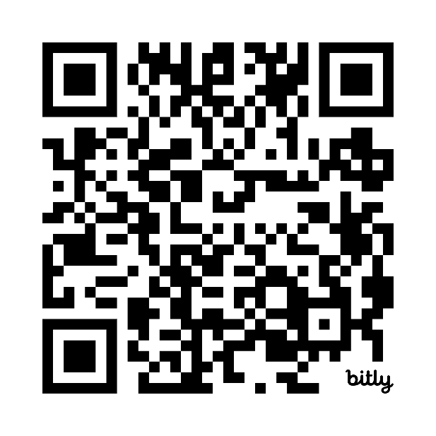
Sosis, R. (2003). Why aren’t we all hutterites?: Costly signaling theory and religious behavior.
Sosis, R. (2023). Costly signaling. The Routledge Handbook of Evolutionary Approaches to Religion.
Tosi, J., & Warmke, B. (2016). Moral grandstanding.
Scan for the full bibliography
Thank you

